Slide 1


Suptechnology Private higher education school of Engineering and Information Technology
End of year project
Conception and development of a 2d platformer game :
Run&Slash
Accomplished by:
WALID MAHBOUB
Academic year :
2024-2025
Supervised by :
ENAANAI ADIL

Slide 2
Presentation plan:
Game Idea
Why This Game?
Game Showcase
Gameplay Mechanics
Animations & Sounds
Development & Struggles
What’s Next?
Questions?

Slide 3
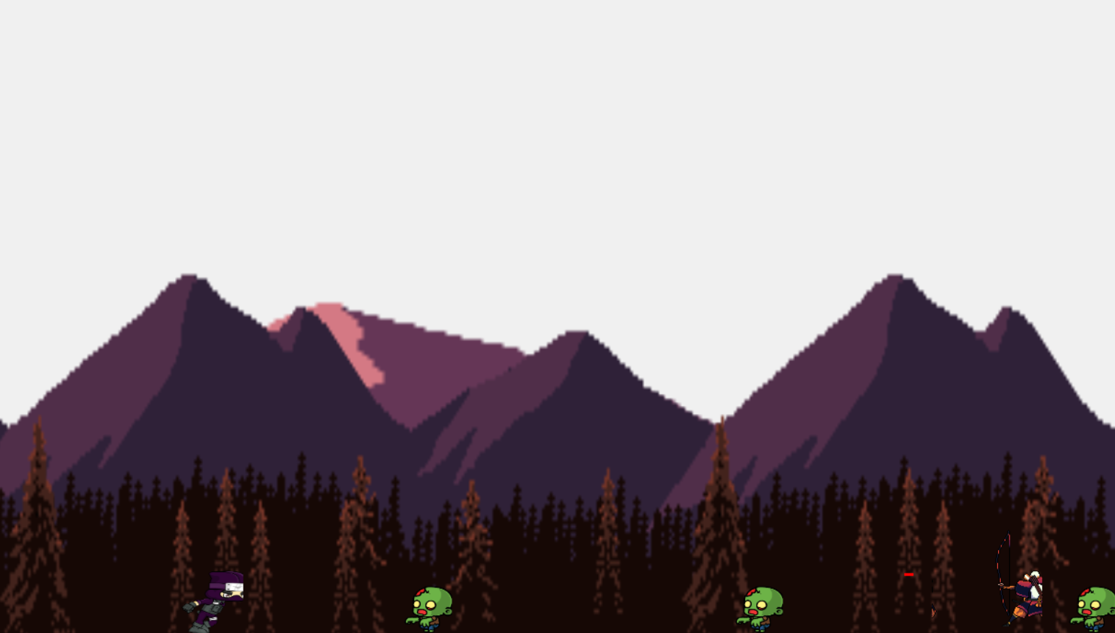
Game Idea:
Run&Slash is a simple 2D platformer where you play as a ninja slashing your way through zombies and archers.

Slide 4
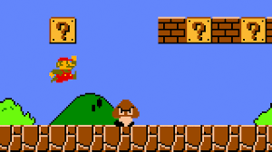
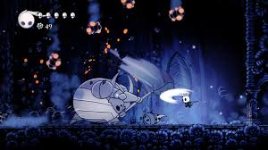
Why This Game?
Super Mario Bros Hollow Knight

Slide 5
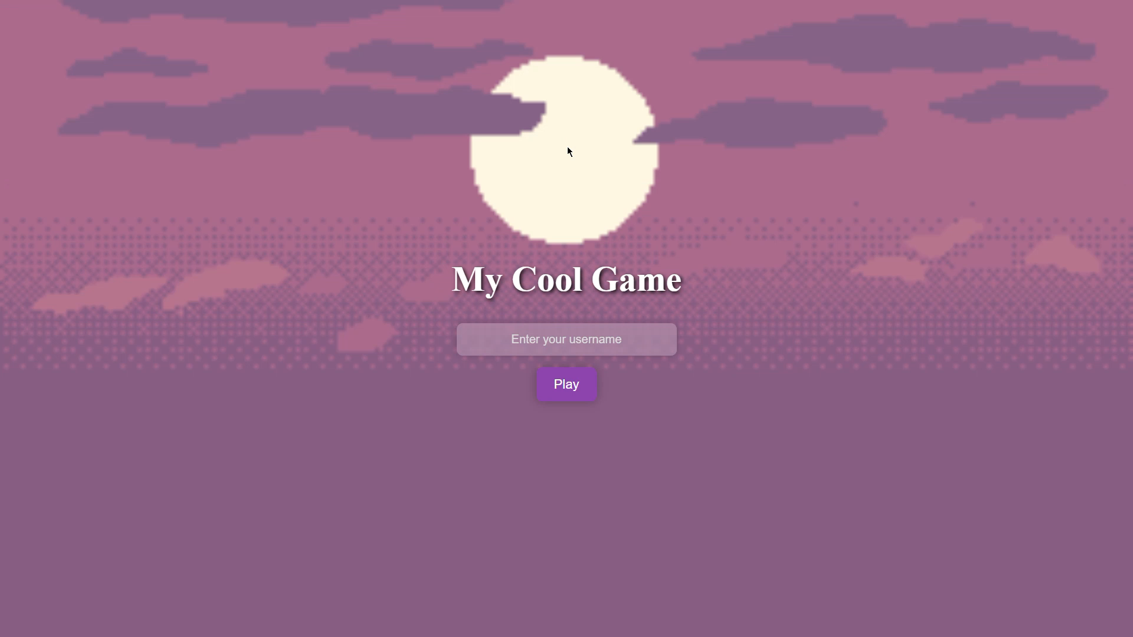
Game Showcase

Slide 6
Gameplay Mechanics

